Slide 1
Biometric Finger Veins Authentication using Deep Learning Algorithm
TEAM MEMBERS:
Pratisha B (211417104195)
Nivedhitaa Ravichandran (21141710172)
Preethi M (211417104198)
Guide Details:
Mrs. V. Sathya Preiya
Associate Professor
DOMAIN:
ARTIFICIAL INTELLIGENCE

Slide 2
INTRODUCTION
Unique to each individual, even among identical twins.
Finger vein recognition is a method that specifies an individual using the vein pattern inside one’s fingers.
_{Less intrusive.}
Extremely difficult to read or steal and hence cannot be duplicated.

Slide 3
Literature Survey
Year of Publishing | Author Name | Title of the Paper | Merits | Demerits
2017 | Lu Yang, Gongping Yang, Yilong Yin, and Xiaoming Xi Link: https://ieeexplore.ieee.org/document/7882665 | Finger Vein Recognition with Anatomy Structure Analysis | Anatomy structure analysis-based vein extraction Extracted by the orientation map-guided curvature based on the valley- or half valley-shaped cross sectional profile Thinned and refined to obtain a reliable vein network | Accurate evaluation of joint damage is low Does not improve the assessment sensitivity in the early stage Lead to the generation of bad candidate proposals
2017 | Lu Yang, Gongping Yang, Xiaoming Xi, Xianjing Meng, Chunyun Zhang and Yilong Yin Link: https://ieeexplore.ieee.org/document/7993012 | Tri-branch Vein Structure Assisted Finger Vein Recognition | Improve the recognition performance of the template matching Supports fused with the whole vein pattern by a user-specific threshold based filter framework Developed based on the imaging characteristic of finger vein that the gray value of vein point | Performance remains unsatisfactory owing to defective vein networks and weak matching Neglect of deep analysis of the vein anatomy structure

Slide 4
Literature Survey
Year of Publishing | Author Name | Title of the Paper | Merits | Demerits
2016 | Xinwei Qiu, Wenxiong Kang, Senping Tian, Wei Jia, Zhixing Huang Link: https://ieeexplore.ieee.org/document/8049353 | Finger Vein Presentation Attack Detection Using Total Variation Decomposition | Efficient and robust method for detecting presentation attacks Detects degrees of blurriness and the noise distribution Encode both structure and noise information in the decomposed components | Does not support pattern based finger vein recognition Computational cost in training the model is high Does not bifurcation point of vein pattern vary largely between the imposter images
2019 | Takao Murakami , Ryo Fujita, Tetsushi Ohki Link: https://ieeexplore.ieee.org/abstract/document/8679987 | Cancelable Permutation-Based Indexing for Secure and Efficient Biometric Identification | Filters are adjusted automatically to extract the most useful information Network performance are assessed for each topologies Eliminate confusing variables | Difficult to form a pattern in the dataset to be applied Model does not use less parameters Existing loss can easily lose important information

Slide 5
Literature Survey
Year of Publishing | Author Name | Title of the Paper | Merits | Demerits
2018 | Wenming Yang, Zhiquan Chen, Chuan Qin, Qingmin Liao Link: https://ieeexplore.ieee.org/document/8374822 | Trimmed Weber Representation and Cross Section Asymmetrical Coding for Human Identification using Finger Images | Equalization ensures that the resulting histogram is smooth Increase the contrast of the main components Clip Limit parameter increases | Does not Implicitly encoding disease label, and location bounding box Does not Exploiting the mutual relationship between labels and the locations of diseases
2018 | Raghavendra Ramachandra, Kiran Raja, Sushma Venkatesh and Christoph Busch Link: https://ieeexplore.ieee.org/document/8672597 | Design and Development of low-cost Sensor to capture ventral and dorsal Finger-vein for Biometric Authentication | More accurate the detection results Performance of the classifier improved significantly Identify and detect with the help of patterns created | Unable to resolve the problem when probability is half by half No better performance as a baseline.

Slide 6
Problem Statement
Finger vein authentication works by utilizing the differences of vein patterns for personal identification.
The authentication process is carried out by comparing the vein pattern that is previously captured during enrollment to the vein pattern that is taken during authentication, and checking if they match.
To achieve this target, it’s necessary to make a combination between hardware design and software procedures. Through hardware design, the system may instruct the user to perform properly to make the pattern recognized easily.
Through software procedures, the system may correct the problems related to the acquisition of the pattern, relying on algorithms that aid to solve irregularities.
Furthermore, the algorithm is able to create the score of similarity in biometrical character from extracted fingerprints, the result of which is assumed to be accurate with infinite decimal.

Slide 7
Development Environment
Backend Technologies
Python
Numpy
Scikit-learn (Sklearn)
TensorFlow & Keras
Frontend Technologies
Jupyter Notebook
Dataset Used
Size: 180MB
No. of samples used: 120 Men and 40 Women
Link: https://www.kaggle.com/ryeltsin/finger-vein

Slide 8
System Architecture

Slide 9
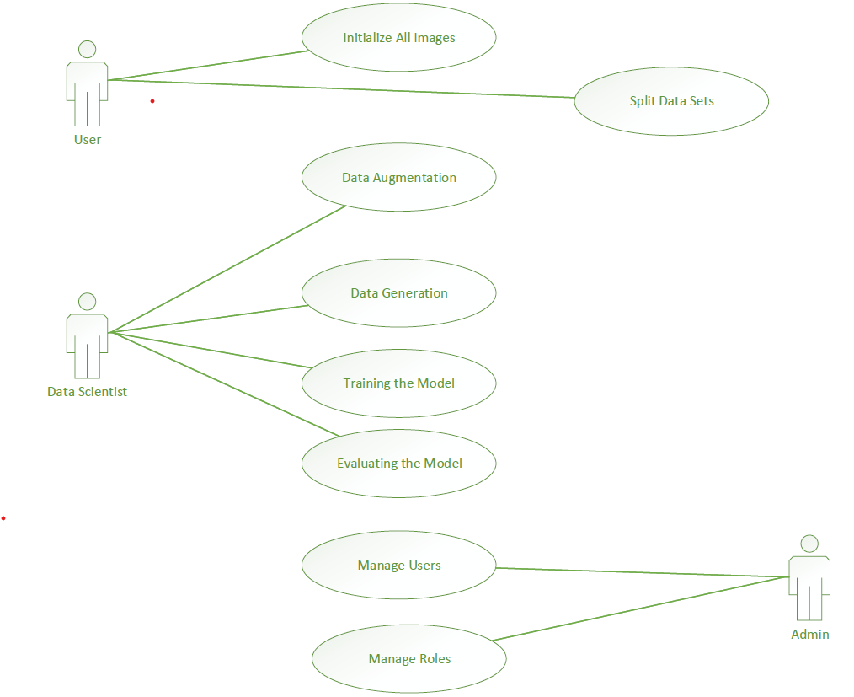
Use Case Diagram

Slide 10
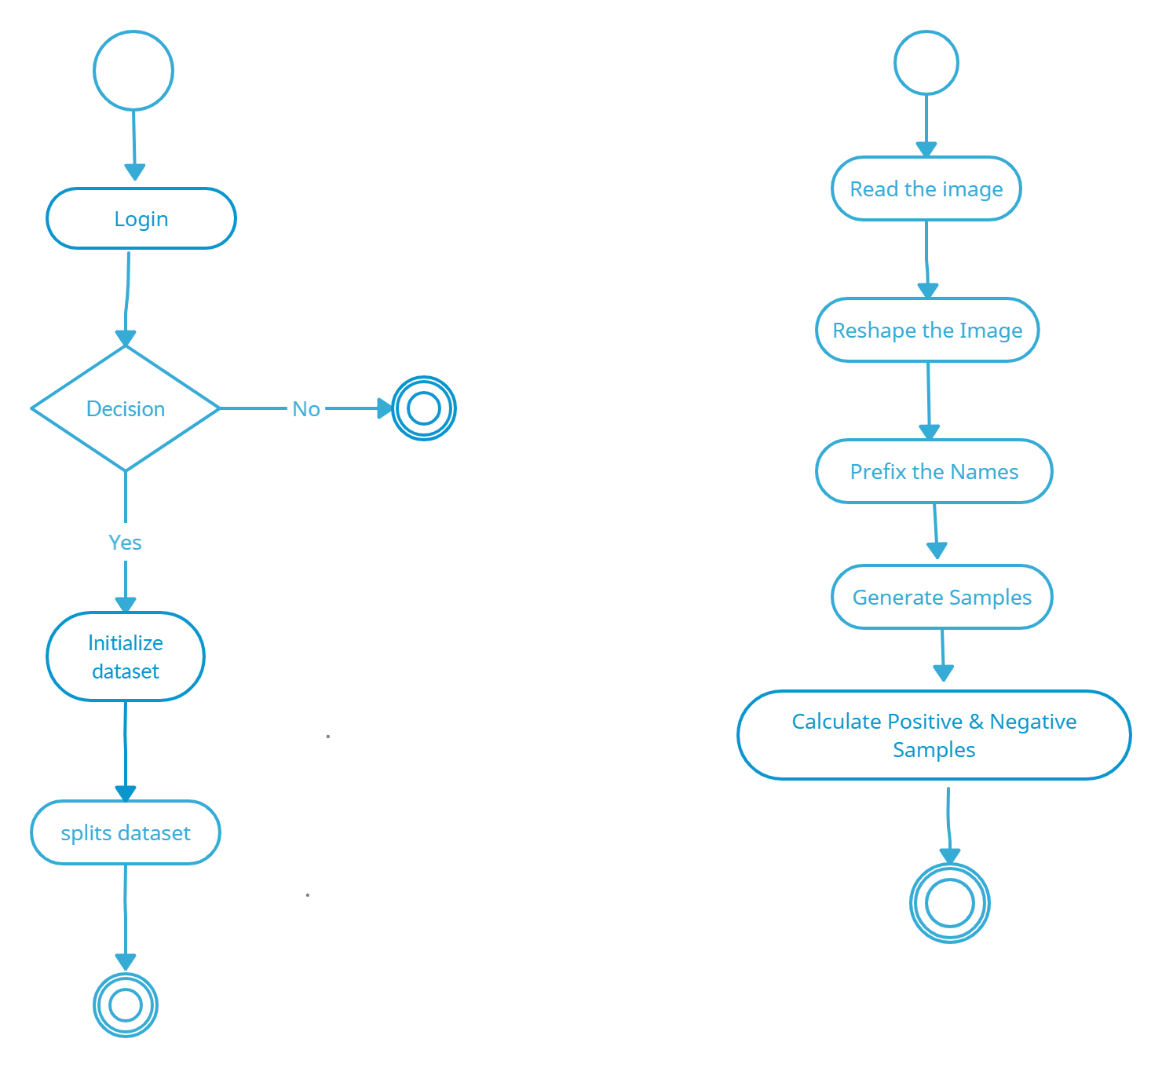
Activity Diagram

Slide 11
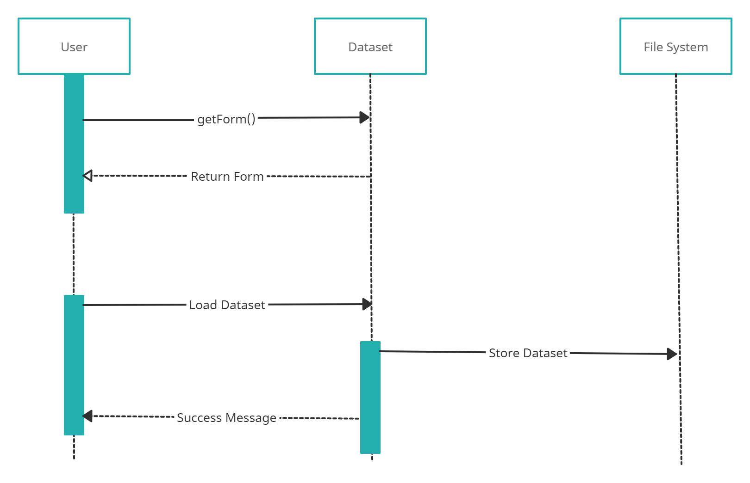
Sequence Diagram

Slide 12
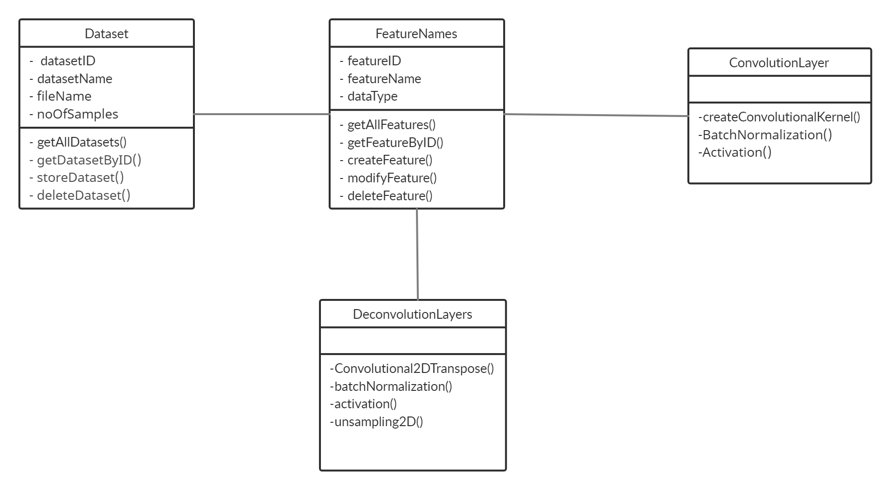
Class Diagram

Slide 13
MODULES Exploratory Data Analysis
Exploratory data analysis is generally cross-classified in two ways.
Non-graphical or graphical.
Univariate or multivariate (usually just bivariate).
Data visualization is a technique that uses an array of static and interactive visuals within a specific context to help people understand and make sense of large amounts of data.
The data is often displayed in a story format that visualizes patterns, trends and correlations that may otherwise go unnoticed.

Slide 14
Dataset Processing
The steps involved in data preprocessing are as follows:
Image Sharpening
Threshold Binary
Erosion
Sobel
Scaling
Contouring

Slide 15
Feature Selection
The number of pixels in an image is the same as the size of the image for grayscale images we can find the pixel features by reshaping the shape of the image and returning the array form of the image.
Edges in an image are the corners where the pixel change drastically, as the images are stored in array form we can visualize different values and see where the change in pixel value is higher but doing it manually takes time

Slide 16
Prediction
ImageDataGenerator class allows rotation of up to 90 degrees, horizontal flip, horizontal and vertical shift of the data..
Exponential Linear Unit (ELU) activation functions : A single fully-connected layer after the last max pooling.
Batch normalization provides a way to apply data processing, similar to the standard score, for the hidden layers of the network
It normalizes the outputs of the hidden layer for each mini-batch (hence the name) in a way, which maintains its mean activation value close to 0, and its standard deviation close to 1

Slide 17
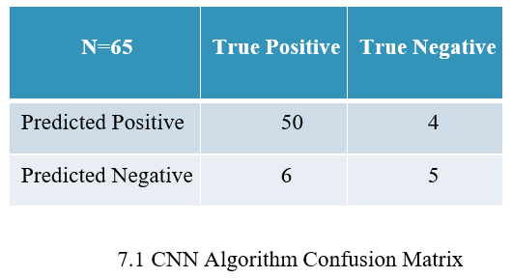
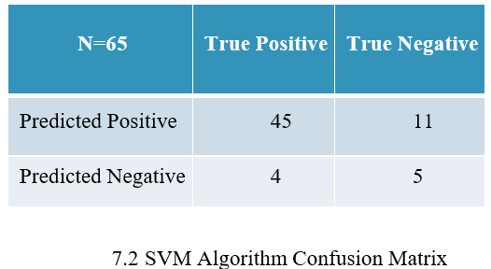
Confusion Matrix

Slide 18
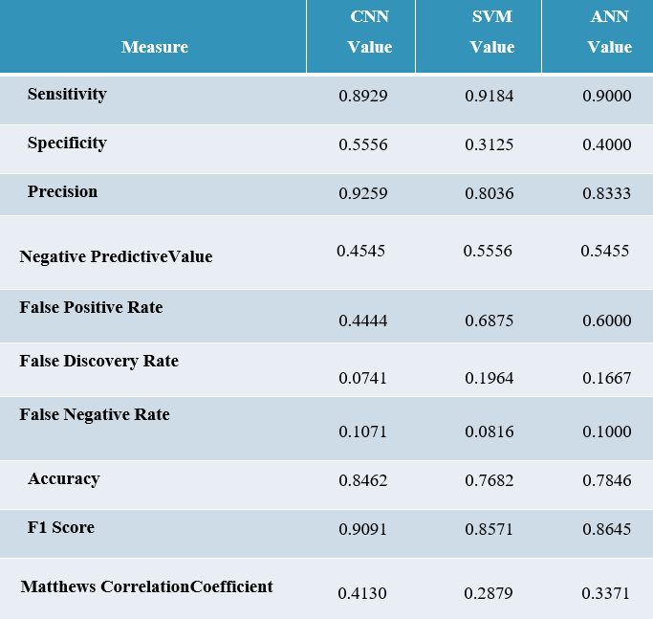
Performance Analysis

Slide 19
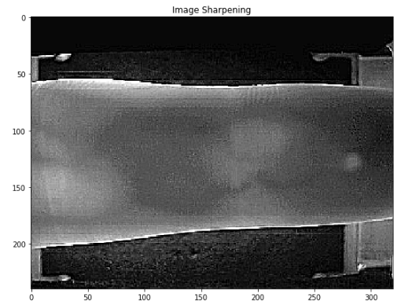
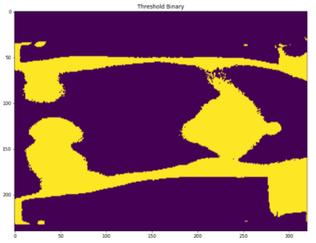
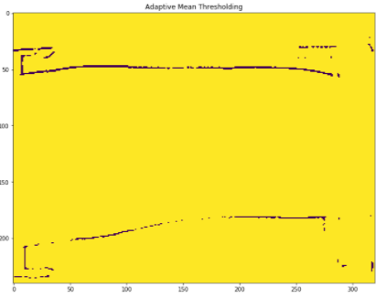
Screenshots

Slide 20
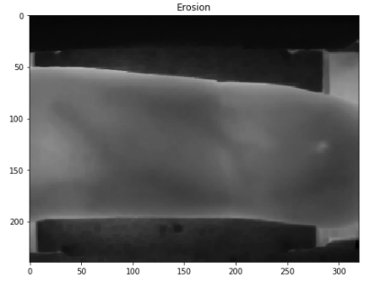
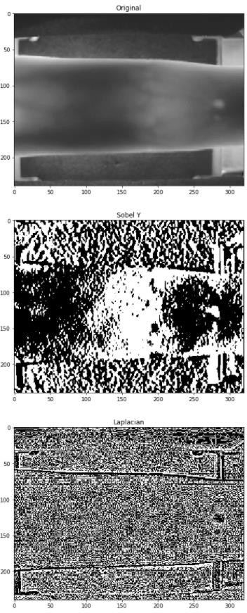
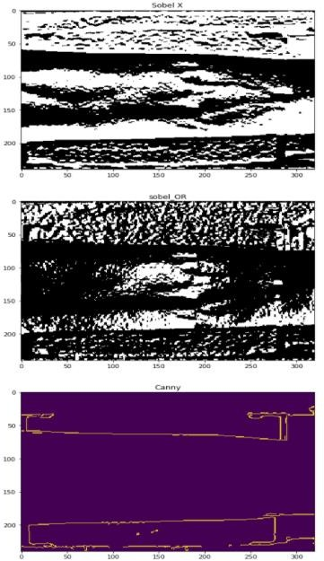
Screenshots

Slide 21
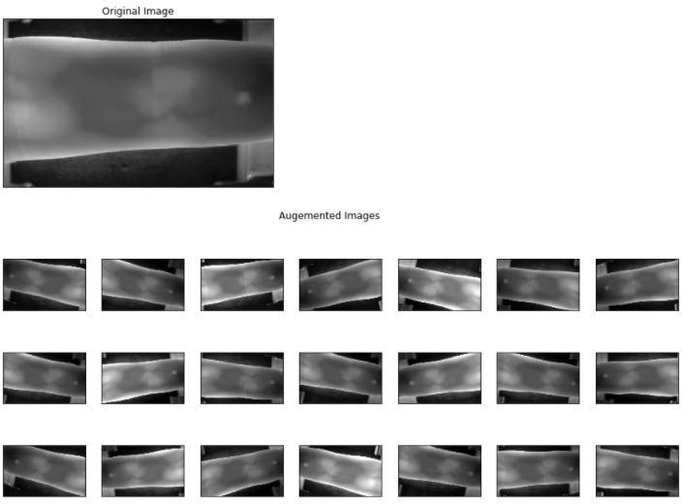
Screenshots

Slide 22
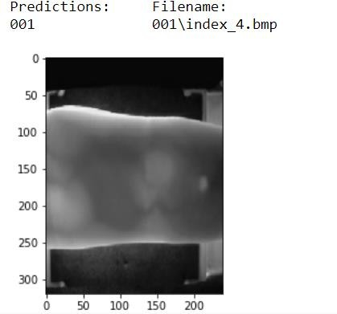
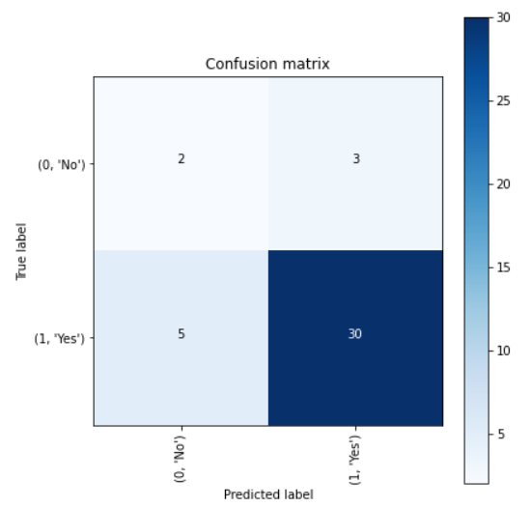
Screenshots

Slide 23
CONCLUSION
Suitable for quantification in the early stage and for use in
large cohorts.
More timely with our quantitative measurements than by ordinal scores.
Our future research is to enhance the existing authentication system by integrating the designed model for finger vein based biometric authentication

Slide 24
REFERENCES
D. De Santos-Sierra, M. F. Arriaga-Gómez, G. Bailador, And C. Sánchez- Ávila, “Low Computational Cost Multilayer Graph- Based Segmentation Algorithms For Hand Recognition On Mobile Phones,” In Proc. Int. Carnahan Conf. Security Technol. (Iccst), Rome, Italy, 2014, Pp. 1–5.
W. Kang And Q. Wu, “Pose-Invariant Hand Shape Recognition Based On Finger Geometry,” Ieee Trans. Syst., Man, Cybern., Syst., Vol. 44, No. 11, Pp. 1510–1521, Nov. 2014.
L. Yang, G. Yang, Y. Yin, And R. Xiao, “Sliding Window-Based Region Of Interest Extraction For Finger Vein Images,” Sensors, Vol. 13, No. 3, Pp.3799–3815, 2013.
Nalini, K., and L. Jaba Sheela. "A survey on datamining in cyber bullying.” International Journal on Recent and Innovation Trends in Computing and Communication 2.7 (2014): 1865-1869.
Sheela, L. Jaba, and V. Shanthi. "DIMAR- Discovering interesting medical association rules form MRI scans." 2009 6th International Conference on Electrical Engineering/Electronics, Computer, Telecommunications and Information Technology. Vol. 2. IEEE, 2009.
K. B. Raja, R. Raghavendra, And C. Busch, “Video Presentation Attack Detection In Visible Spectrum Iris Recognition Using Magnified Phase Information,” Ieee Transactions On Information Forensics And Security, Vol. 10, No. 10, Pp. 2048-2056, 2015.

Slide 25
THANK YOU

